Slide 1
Intro to APL
Yonathan Torres

Slide 2
Contents
About APL
Language Comparisons
Other APL examples

Slide 3
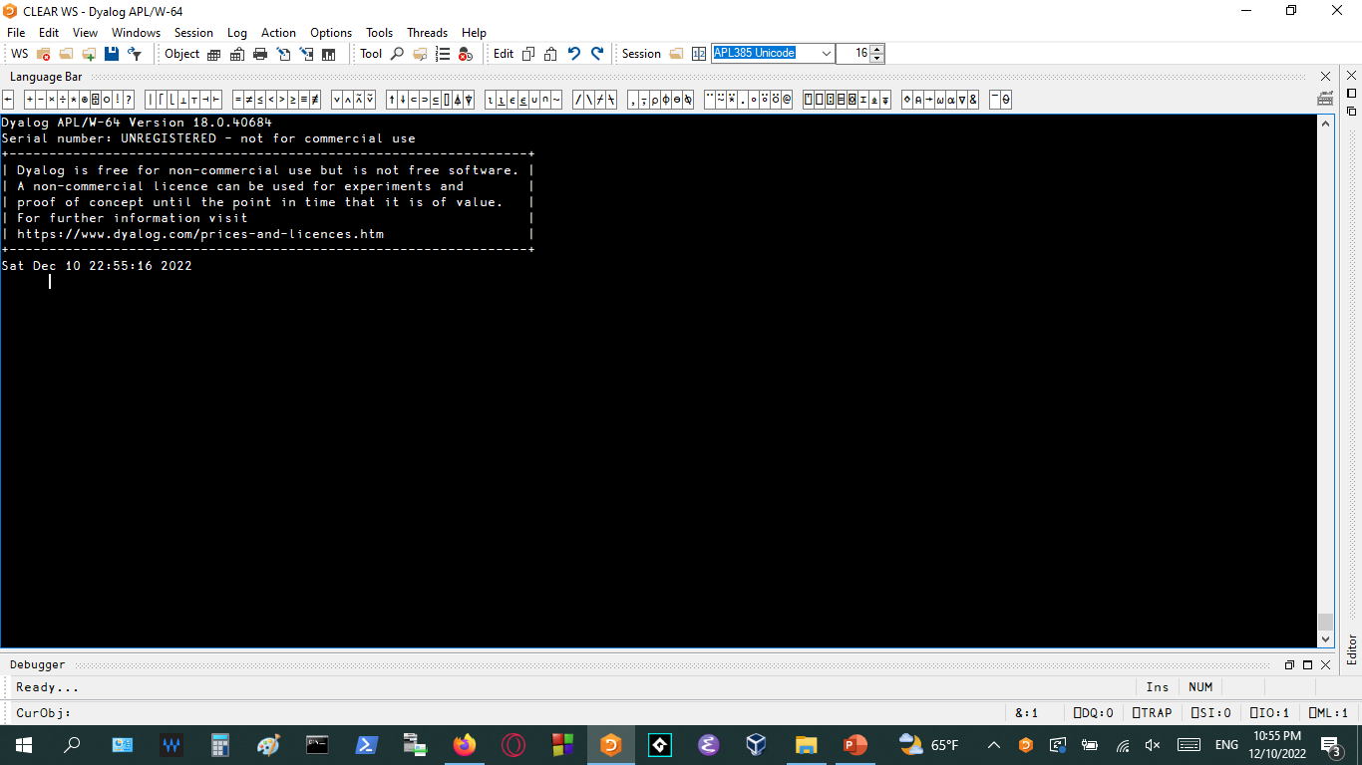
About APL
APL stands for A Programming Language.
Invented in the 1960s by Kenneth E. Iverson.
It is an array-oriented language as well as a functional programming language.
All data is stored as multi-dimensional arrays.
Dyalog APL engine

Slide 4
Language Comparisons
Like JavaScript and Python shells, APL uses a REPL environment which allows you to

Slide 5
Other Examples
Find other APL programs that people have made to demonstrate what you can do

